Slide 1
Circular & Doubly Linked List

Slide 2
Circular Linked List

Slide 3
CIRCULAR LINKED LIST
In a circular linked list, the last node contains a pointer to the first node of the list. While traversing a circular linked list, we can begin and traverse the list in forward direction until we reach the same node where we started.

Slide 4
Inserting a New Node in a Circular Linked List
Case 1: The new node is inserted at the beginning of the circular linked list.
Case 2: The new node is inserted at the end of the circular linked list.
Case 3: insertion In the middle

Slide 5
Insertion at the Beginning
Steps to insert a Node at beginning :
The first Node is the Head for any Linked List.
When a new Linked List is instantiated, it just has the Head, which is Null.
Else, the Head holds the pointer to the first Node of the List.
When we want to add any Node at the front, we must make the head point to newly added node. And the Next pointer of the newly added Node, must point to the previous Head, whether it be NULL(in case of new List) or the pointer to the first Node of the List.
The previous Node pointed by Head is now the second Node of Linked List, because the new Node is added at the front.

Slide 6
class Node
{
int info;
Node *next;
};
class circular_llist
{
public:
Node *last;
circular_llist()
{last = NULL;}
};

Slide 7
Algorithm
void circular_llist::add_begin(int val)
{
node *temp = new Node();
temp->info=val;
if (last == NULL)
{
last=temp;
temp->next=last;
}
else
{
temp->next = last;
last = temp;
}

Slide 8
Algorithm- Comparison
Circular
void circular_llist::add_begin(int val)
{
node *temp = new Node();
temp->info=val;
if (last == NULL)
{
last=temp;
temp->next=last;
}
else
{
temp->next = last;
last = temp;
}
Single
void insert_beg(int val)
{ node *temp=new node;
temp->info=val;
If(head==NULL)
{
head=temp;
temp->next=NULL
}
else{
temp->next=head;
head=temp; }
}

Slide 9
Insertion at the Middle of Circular Linked List
Insert between Pre and Cur
of a Circular Linked List
New->next = Cur;
Prev->next = New;
10
20
55
70
40
Prev
Cur
Last
New

Slide 10
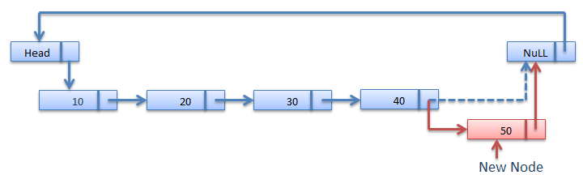
Insertion at the Last of Circular Linked List
While (cur->next != Head)
Cur=cur ->next;
cur->next = New;
New->next = Head;

Slide 11
void insertNode( int item,int pos){
Node *New = new Node();
Node *Prev;
Node *Cur;
New->data = item;
if(last == NULL){ // insert into empty list
last = New;
last->next = last;
}
Prev = last;
Cur = last->next;
for (int i=1;i<pos;i++)
{Prev = Cur;
Cur = Cur->next;
}
New->next = Cur;
Prev->next = New;
}

Slide 12
void insertNode( int item,int pos){
Node *New = new Node();
Node *Prev;
Node *Cur;
New->data = item;
if(last == NULL)
{
last = New;
last->next = last;
}
Prev = last;
Cur = last->next;
for (int i=1;i<pos;i++)
{ Prev = Cur;
Cur = Cur->next;
}
New->next = Cur;
Prev->next = New;
}
void insert_position(int pos, int val)
{
node *temp=new node;
node *pre;
node *cur;
temp->data=val;
If(head==NULL)
{
head=temp;
temp->next=NULL
}
cur=head;
for(int i=1;i<pos;i++)
{ pre=cur; cur=cur->next; }
temp->next=cur;
pre->next=temp
}

Slide 13
Deletion
Circular Linked List

Slide 14
Delete a node
from a single-node Circular Linked List
Last = NULL;
delete Cur;
10
Last = Cur = Prev

Slide 15
Delete the head node
from a Circular Linked List
while(Prev->next!=last)
{ Prev=Cur; Cur=Cur->next;}
Prev->next = Cur->next;
delete Cur;
10
20
40
55
70
Rear
Prev
Cur

Slide 16
Delete a middle node Cur
from a Circular Linked List
For (i=1;i<=position;i++)
{ Prev=Cur; Cur=Cur->next;}
Prev->next = Cur->next;
delete Cur;
10
20
40
55
70
Prev
Cur
Rear

Slide 17
Delete the end node
from a Circular Linked List
while(Cur->next!=last)
{ Prev=Cur; Cur=Cur->next;}
Prev->next = Cur->next;
delete Cur;
10
20
40
55
70
Prev
Cur

Slide 18
Doubly Linked List

Slide 19
Doubly Linked List
A doubly linked list or a two-way linked list is a more complex type of linked list which contains a pointer to the next as well as the previous node in the sequence. Therefore, it consists of three parts—
data,
a pointer to the next node,
a pointer to the previous node

Slide 20
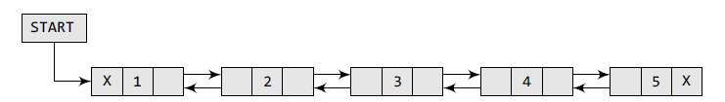
class Node
{
int info;
Node *next;
Node *pre;
};
The PREV field of the first node and the NEXT field of the last node will contain NULL.
The PREV field is used to store the address of the preceding node, which enables us to traverse the list in the backward direction.

Slide 21
Inserting a New Node in a Doubly Linked List
Case 1: The new node is inserted at the beginning.
Case 2: The new node is inserted at the end.
Case 3: The new node is inserted after a given node.
Case 4: The new node is inserted before a given node.

Slide 22
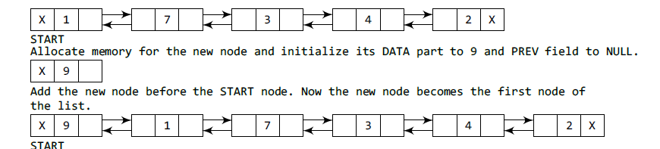
Inserting a Node at the Beginning
node *temp=new node;
temp->info=val; temp->prev=NULL;
If(start==NULL)
{ start=temp; temp->next=NULL;}
else{
temp->next=start;
start->prev=temp;
start=temp;
}

Slide 23
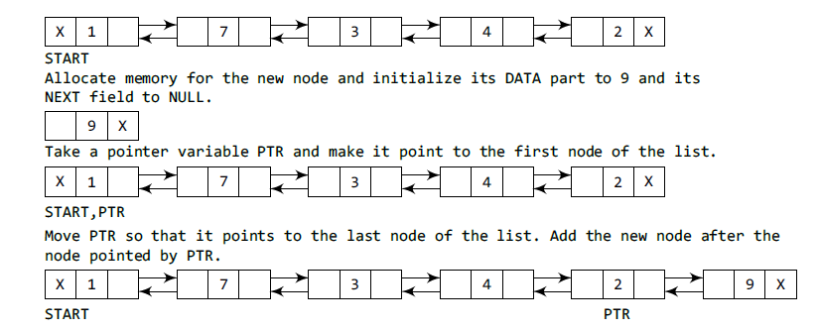
Inserting a Node at the End
node *temp=new node;
temp->info=val; temp->next=NULL;
Node *ptr = start;
while(ptr->next!=NULL)
{ ptr=ptr->next; }
ptr->next=temp;
temp->prev=ptr

Slide 24
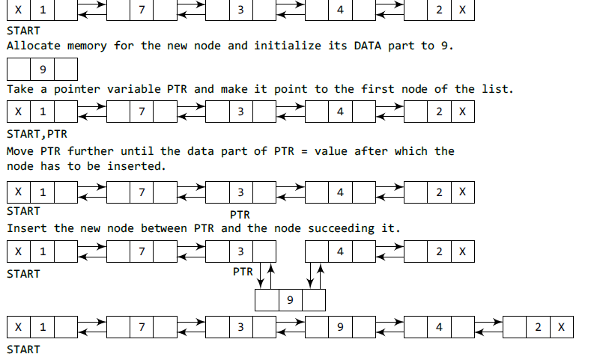
Inserting a Node After a Given Node
node *temp=new node; temp->data=data;
cur=start;
while (pre->data!= sp_val)
{ pre=cur; cur=cur->next; }
temp->next=cur; temp->prev=pre;
pre->next=temp;
cur->prev==temp;

Slide 25
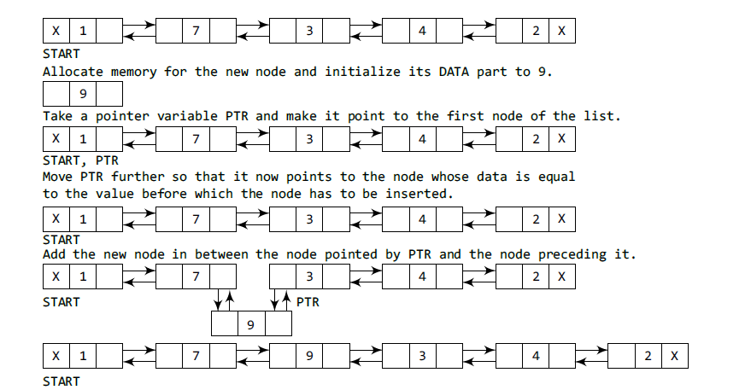
Inserting a Node Before a Given Node in a Doubly Linked List

Slide 26
Deleting a Node from a Doubly Linked List

Slide 27
Deleting a Node from a Doubly Linked List
Case 1: The first node is deleted.
Case 2: The last node is deleted.
Case 3: The node after a given node is deleted.
Case 4: The node before a given node is deleted

Slide 28
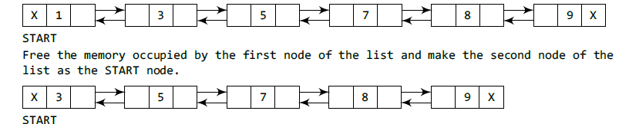
Deleting the First Node
if (start==NULL)
cout<<“Underflow<<endl;
else
node *ptr;
ptr = head;
head=head→next;
head->prev=NULL
delete ptr;

Slide 29
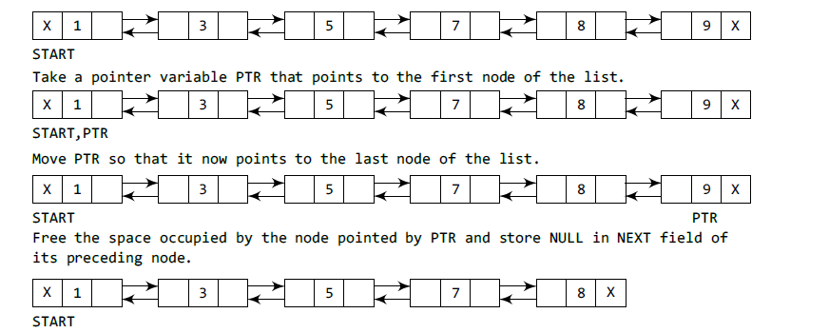
Deleting the Last Node
while(Cur->next!=NULL)
{ Prev=Cur; Cur=Cur->next;}
Prev->next = NULL;
delete Cur;

Slide 30
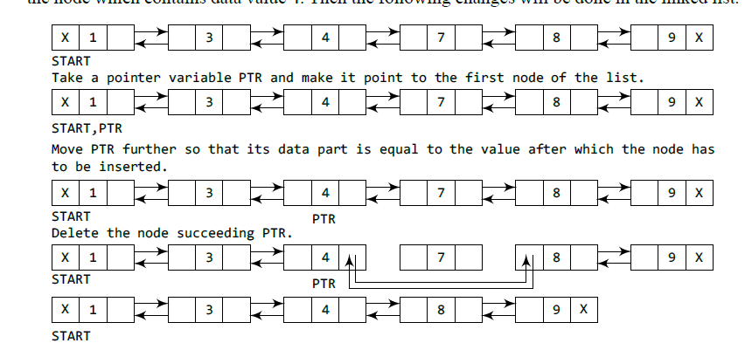
Deleting the Node After a Given Node
cur=start;
while (pre->data!= sp_val)
{ pre=cur; cur=cur->next; }
pre->next=cur->next;
(cur->next)->prev=pre;
delete Cur;

Slide 31
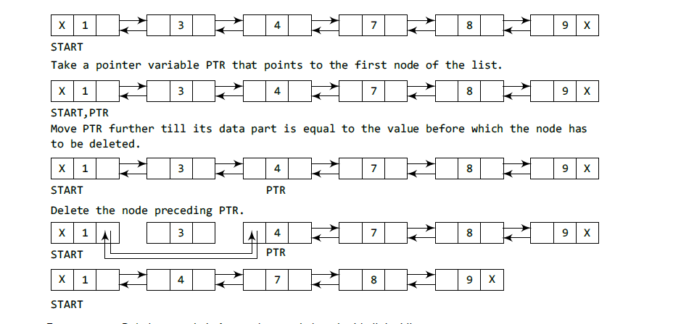
Deleting the Node Before a Given Node in a Doubly Linked List

Slide 32
Practice Activity
Implement Doubly Linked list by writing functions for all possible operations in doubly linked list.

Slide 33
Complexity Analysis of Linked List Operations
List Type | Time Complexity
 | Worst
 | Search | Insertion | Deletion
Singly-Linked List
Doubly-Linked List
Circular Linked List

